Slide 1
Mixtures

Slide 2
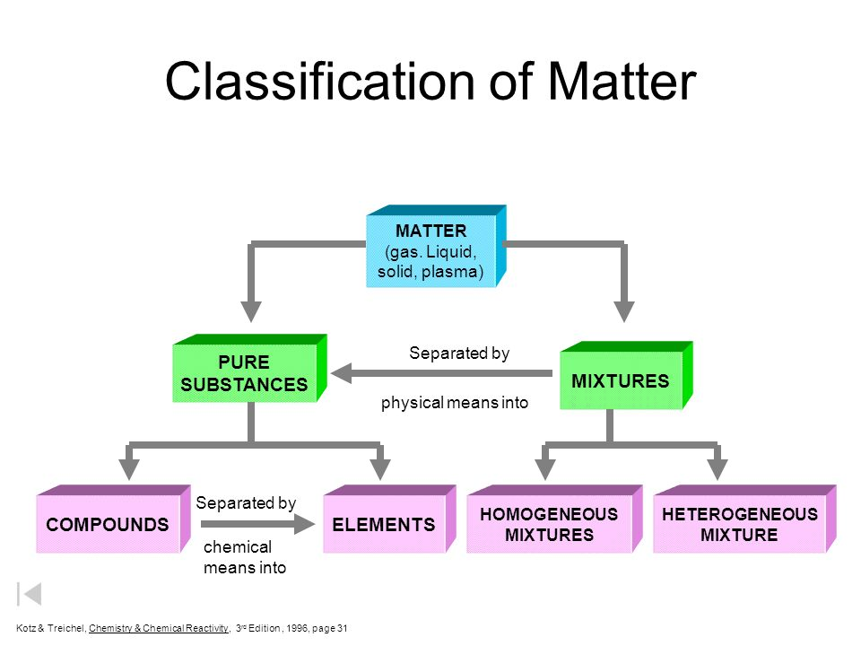

Slide 3
Sorting Substances
How can these substances be sorted? Come up with as many ways as you can.
Which methods of sorting would be useful in chemistry?
You will need to define your groups carefully, write some accurate definitions.

Slide 4
Classifying Substances
Define these key terms:
Atom
Molecule
Element
Compound
Mixture
Pure
Impure

Slide 5
Pure substances
Have a fixed or constant composition
Cannot be separated by physical means
Have well defined physical properties, eg:
melting point
boiling point
hardness
density
colour
Have constant chemical properties

Slide 6
Mixtures
Contain two or more different substances, in proportions that can vary
Properties vary with composition, depend on the identity and amounts of constituents
Properties of individual constituents can be used to separate the mixture

Slide 7
Homogeneous materials
Have uniform composition throughout
Includes all pure substances (elements and compounds) and some mixtures
The only kind of mixture that is homogeneous is a solution, eg: salt water

Slide 8
Heterogeneous materials
Heterogeneous materials are non-uniform – you can see differences from one section to another
The constituents are physically separated, eg: in a different phase
Examples include:
Granite (mixture of different mineral grains)
Milk (fat globules suspended in water)
Toothpaste (solid particles suspended in liquid)

Slide 9
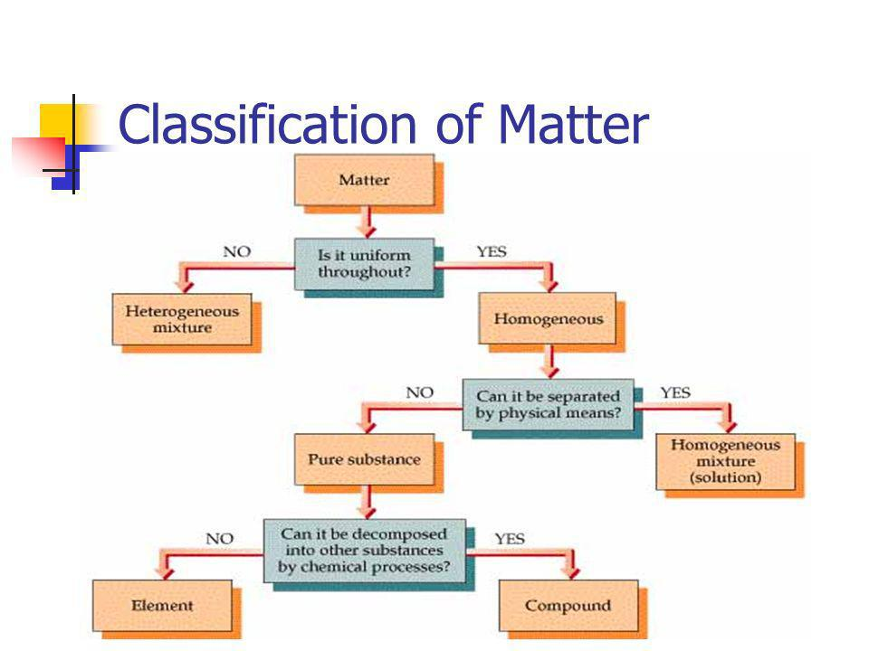

Slide 10
Separating Mixtures
Mixtures can be separated by any means that makes use of the different physical properties of its constituents.
The properties of the components of a mixture determine the best separation method.

Slide 11
Methods of separation
Find out how each of these methods can be used to separate a mixture.
Give an example of a mixture that could be separated by each method.
Sieving
Filtration (diagram)
Decanting
Use of separation funnel (diagram)
Distillation (diagram)
Fractional distillation (basic diagram)
Electrostatic attraction
Magnetic susceptibility
Vaporisation
Crystallisation

Slide 12
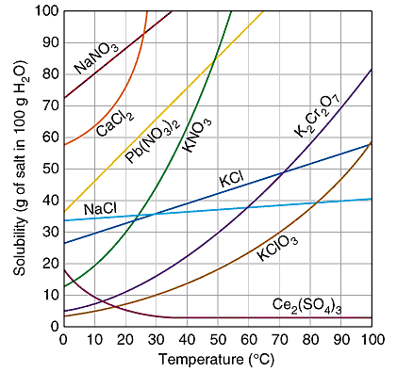

Slide 13
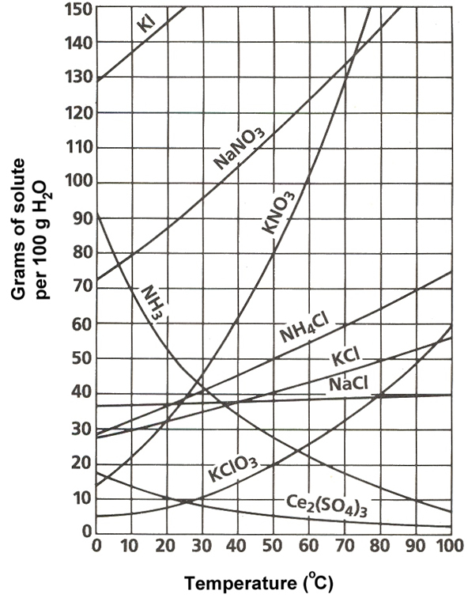
Solubility Curves

